Slide 1

Smart Recipe Recommender
An intelligent system that suggests recipes based on available ingredients—even just one ingredient unlocks culinary possibilities.

Slide 2

Project Objective
The Challenge
The Solution
Ever stared at your pantry wondering what to cook? Our Smart Recipe Recommender solves this by matching your available ingredients to delicious recipes.
Enter any ingredient—even just one—and discover recipes you can make. The system intelligently matches what you have and shows what's missing.

Slide 3

Core Features
Intelligent Matching
Multi-Cuisine Database
Advanced algorithm matches your ingredients with compatible recipes instantly.
Access 100+ recipes spanning global cuisines from Indian to Japanese.
Simple Interface
Ingredient Tracking
Clean console-based design makes recipe discovery effortless.
See both matched and missing ingredients for every recipe suggestion.

Slide 4



How It Works
Recipe Database
Matching Logic
User Interaction
get_recipes() stores 100+ recipes organized by cuisine type in dictionary format.
recommend_recipes() compares your ingredients against the database and finds matches.
main() handles input and displays suggestions with matched and missing ingredients.

Slide 5

Code Architecture
get_recipes()
recommend_recipes()
main()
Recipe Database
User Interface
Matching Engine
Dictionary-based storage
Input handling
Ingredient comparison
Output formatting
Categorized by cuisine
Match calculation
Clean display
Ingredient lists per recipe
Missing item tracking

Slide 6
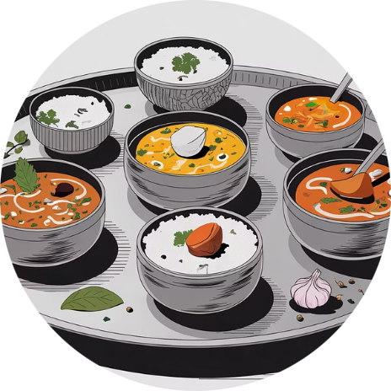
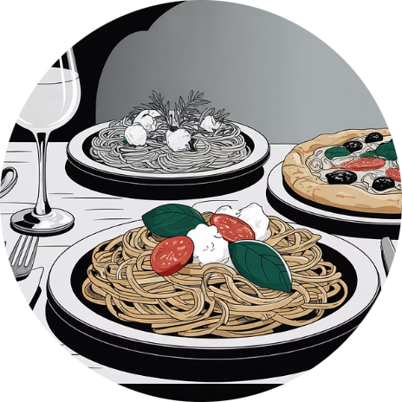
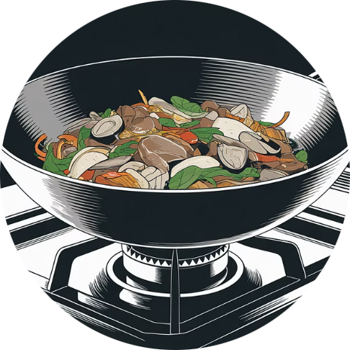
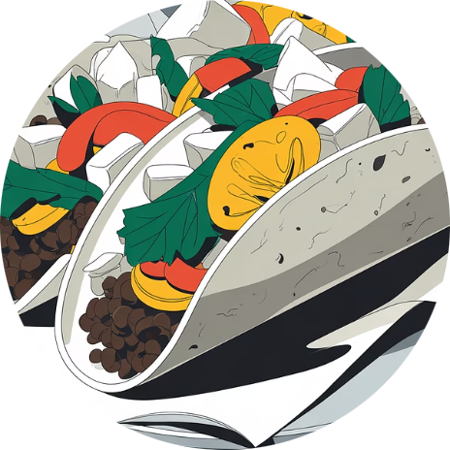
Global Cuisine Coverage
Indian
Italian
Chinese
Mexican
Aromatic curries and traditional dishes
Classic pasta and Mediterranean flavors
Stir-fries and traditional recipes
Bold flavors and vibrant dishes

Slide 7
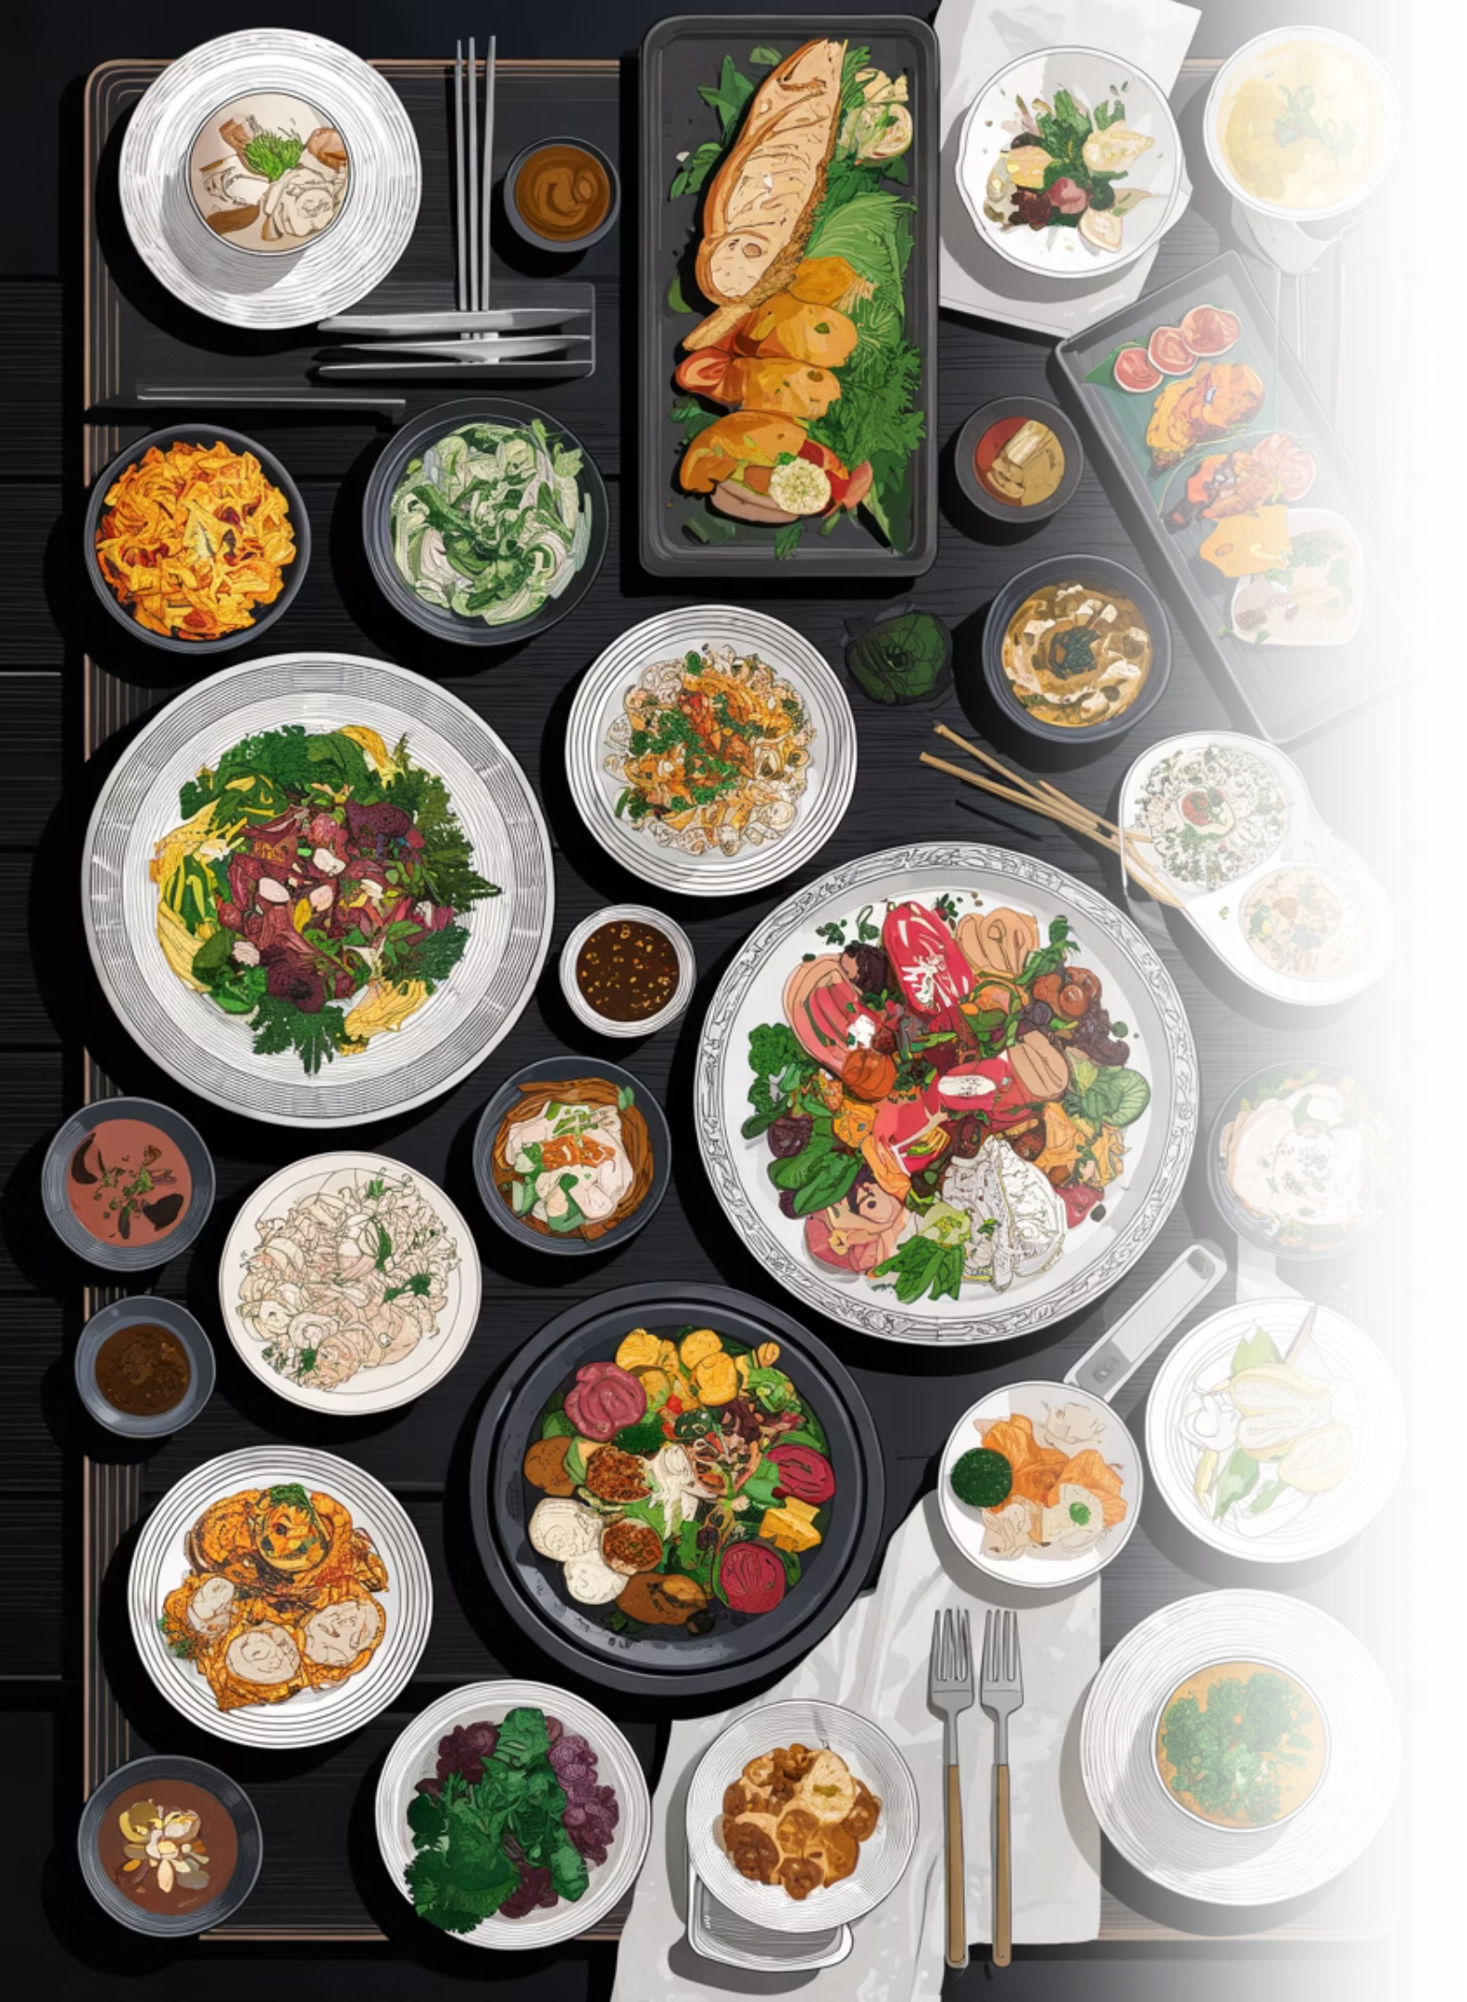
More Cuisines
American
Comfort food classics and BBQ favorites
Japanese
Sushi, ramen, and traditional dishes
Middle Eastern
Hummus, falafel, and aromatic spices
Desserts & Drinks
Sweet treats and refreshing beverages

Slide 8
Technical Concepts
01
02
03
Dictionaries & Nested Data
Loops & Conditionals
String Manipulation
Organized recipe storage with hierarchical structure for efficient data management.
Iterative ingredient matching with conditional logic for accurate recommendations.
Processing and comparing ingredient names for flexible matching.
04
05
List Comprehension
User Input Handling
Efficient filtering and transformation of recipe data.
Clean interface for ingredient entry and result display.

Slide 9
Future Enhancements
GUI Development
Voice Input
Build visual interface using Tkinter or Streamlit for enhanced user experience.
Enable hands-free ingredient entry while cooking.
1
2
3
4
Favorites Feature
Mobile Web Interface
Allow users to save and organize their preferred recipes.
Create responsive design for on-the-go recipe discovery.

Slide 10



Transform Ingredients into Inspiration
The Smart Recipe Recommender makes cooking accessible and exciting—turning whatever you have into delicious possibilities.

